Slide 1


Machine Learning Project: Stock Trading
By Arjun Patel

Slide 2

Introduction
Problem
Given a certain day, when should we buy a stock?
If we know if a stock is going to go up on a certain day, can we make money?

Slide 3
Data Collection
Yahoo Finance
Data on price movement for QQQ
Federal Reserve
Weekly Economic Index (Reported Weekly and contains 10 indexes)
Redbook same-store sales
Rasmussen Consumer Index
new claims for unemployment insurance
steel production..
Federal Funds Effective Rate (Reported Daily 7 day)
ICE data sources

Slide 4
Data TAble
 | Actual_Close | Target | Close | High | Low \ | Open | Volume | WEI | DFF
Date
1/8/08 | 41.232956 | 0 | 42.331474 | 42.709356 | 41.681169 | 42.5336 | 235083600 | 0 | 4.27
1/9/08 | 42.111759 | 1 | 41.232956 | 42.849935 | 41.232956 | 42.419328 | 261669800 | 0 | 4.26
1/10/08 | 42.17329 | 1 | 42.111759 | 42.146912 | 40.828722 | 41.399939 | 254011800 | 0 | 4.26
1/11/08 | 41.347206 | 0 | 42.17329 | 42.542382 | 41.558134 | 41.681165 | 249958500 | 0 | 4.23
1/14/08 | 42.067806 | 1 | 41.347206 | 41.979938 | 41.03963 | 41.944786 | 211685200 | 1.63 | 4.24
... | ... | ... | ... | ... | ... | ... | ... | ... | ...
11/18/22 | 284.820007 | 1 | 284.809998 | 286.320007 | 280.720001 | 280.880005 | 55462100 | 0 | 3.83
11/21/22 | 281.890015 | 0 | 284.820007 | 287.98999 | 282.320007 | 287.890015 | 53351400 | 1.39 | 3.83
11/22/22 | 285.950012 | 1 | 281.890015 | 284.579987 | 281.040009 | 283.399994 | 40083500 | 0 | 3.83
11/23/22 | 288.820007 | 1 | 285.950012 | 286.109985 | 280.459991 | 282.640015 | 41873400 | 0 | 3.83
11/25/22 | 286.920013 | 0 | 288.820007 | 289.459991 | 285.790009 | 285.970001 | 46390000 | 0 | 3.83

Slide 5
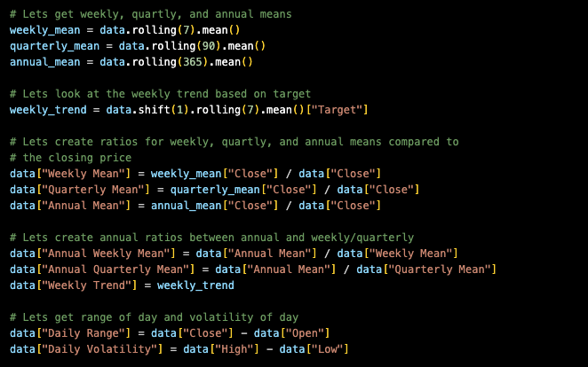
Adding More Variables

Slide 6
Models
Random Forest Classifier
Logistic Regression
Decision Tree Classifier
GaussianNB (Naïve Bayes)

Slide 7
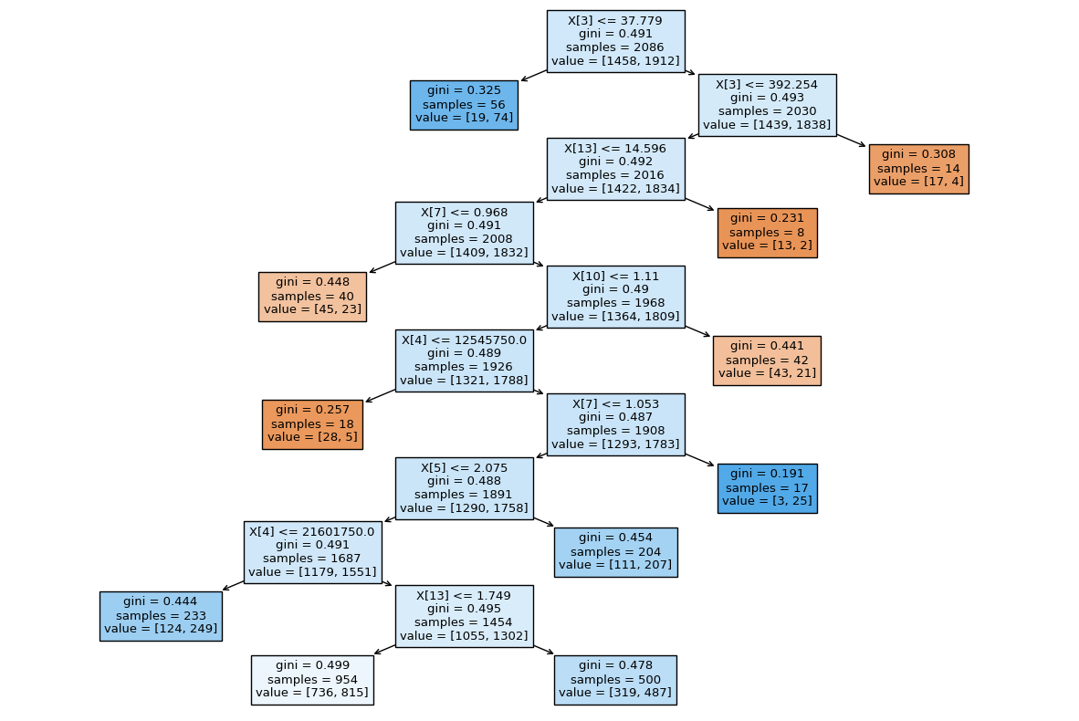
Random Forest Classifier
Create multiple tress and let them vote on whether the day will be up or down
This had an accuracy of 57%

Slide 8
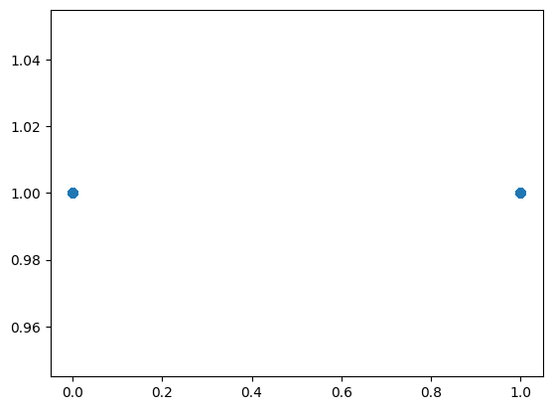
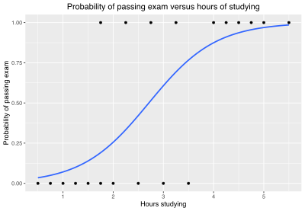
Logistic Regression
Real Data
We are only analyzing 1 and 0
1 means we should expect the day to be up
0 means we should expect the day to be down
This had an accuracy of 56%
Example Data

Slide 9
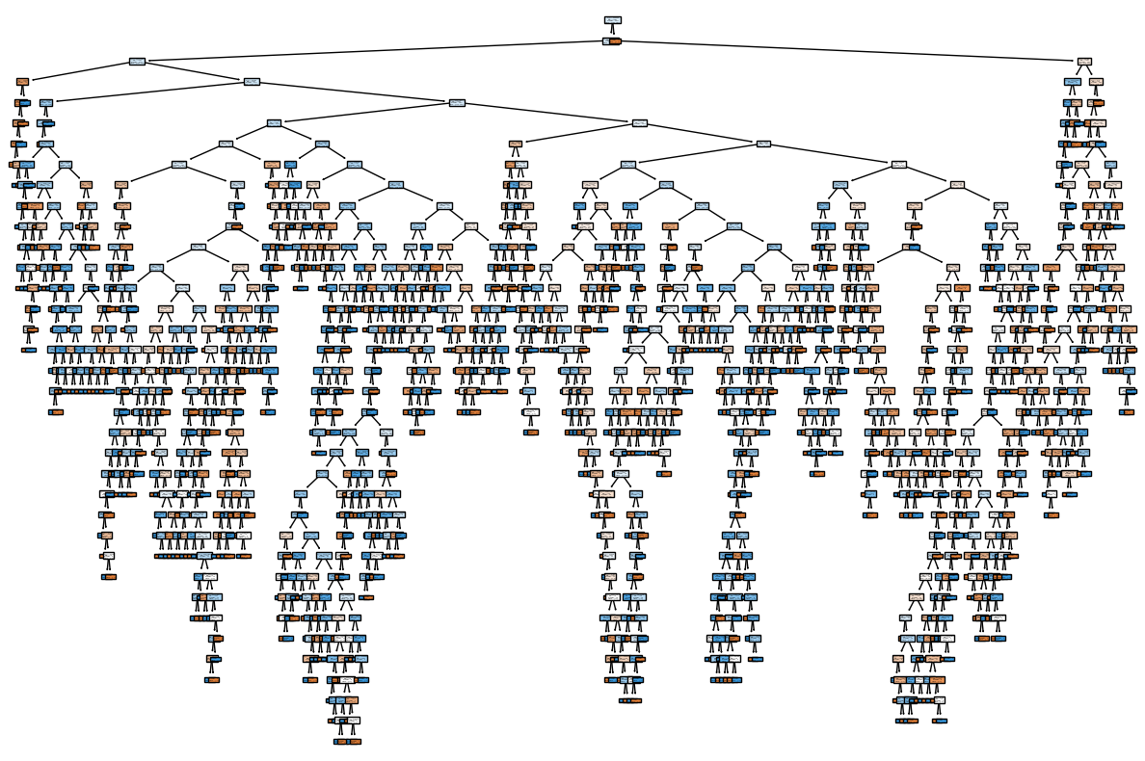
Decision Tree Classifier (Single)
This is the visualization of a single tree
There are many paths you can take, which makes the model complicated
Accuracy is 56%

Slide 10
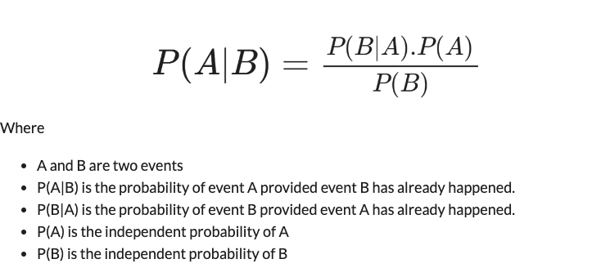
Gaussian NB (Naïve Bayes)
Here is a simplistic way of describing what Naïve Bayes Theorem states
Accuracy is 56%

Slide 11
Back testing
Instead of creating a test that takes the last 30% of the data
We should start at a specific date and let the model run each 30 days
This way we get a better understanding of the accuracy of the model

Slide 12
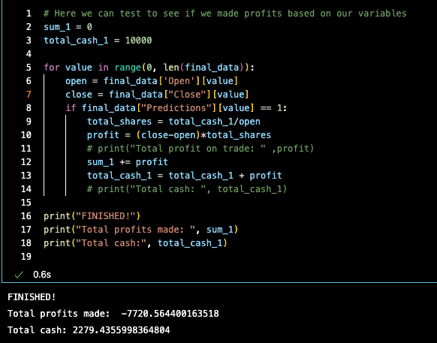
How to Incorporate ML into Algo Trade

Slide 13
Readjust and Incorporate Strategy
Instead of selling for a loss when the model thought the price should be up, lets incorporate rules stating:
Instead of investing 100%, lets invest 50% each time to reduce risk
If we buy on the open and the close price is less than the open price, lets hold onto our position
If our current status of our position is hold and the close price is lower than our original buy price, lets invest 5% of our leftover cash
Once the close price is above our original buy price, lets sell for a profit

Slide 14
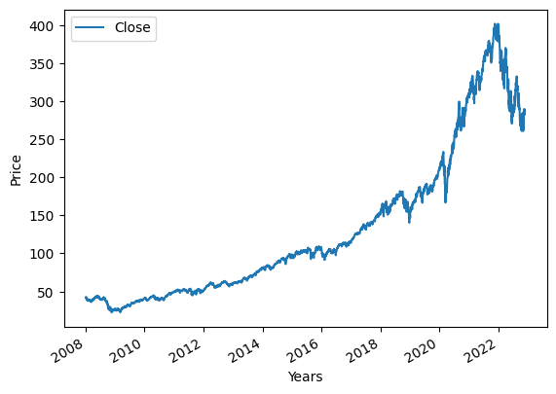
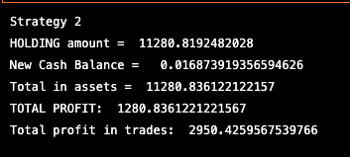

Final ResultS Using Random Forest Classifier

